Slide 1

Automated Code Quality for Python - Group #9
Enhancing Python development with automated Flake8 checks, integrated into CI/CD pipelines using Jenkins, Docker, and Webex notifications.

Slide 2








Project Overview
This project demonstrates an automated code quality pipeline designed for Python applications. It integrates essential DevOps tools to detect coding errors and style violations, enforce consistent coding standards, and provide real-time feedback to development teams.
Build Docker Image
Clone Repository
Create a reproducible environment with Python, Flake8, and application files.
Initial step to fetch the project source code.
Webex Notification
Run Flake8 Checks
Alert the team with real-time build and quality status.
Execute code quality analysis inside the Docker container.

Slide 3
Sample Application: sample_app.py
The provided sample_app.py is intentionally designed with common Flake8 errors to illustrate how the automated checks identify violations.
F401: Unused Import
The json module is imported but never used, indicating dead code.
E261/E262: Spacing Errors
Inconsistent spacing after comments and in variable assignments (e.g., DEFAULT_TIMEOUT = 30).
E201: Whitespace Before Colon
Incorrect spacing in dictionary key-value pairs (e.g., 'name' : 'Alice').
Indentation Warnings
Extra blank lines or inconsistent indentation can trigger further style violations.

Slide 4
Addressing Code Quality Issues
Correcting the identified Flake8 issues is crucial for maintaining a clean and readable codebase. Once these are resolved, Flake8 reports will show a clean bill of health.
Before Correction (Errors)
After Correction (Clean)
import os import json # F401: 'json' unusedclass AppConfig: # E261/E262: multiple spacesDEFAULT_TIMEOUT = 30user_data = { 'name' : 'Alice' } # E201: space before colon
import osclass AppConfig:DEFAULT_TIMEOUT = 30user_data = { 'name': 'Alice' }
A clean codebase not only passes automated checks but also significantly improves maintainability and collaboration.

Slide 5
Dockerfile for Reproducible Builds
The Dockerfile creates a consistent and isolated environment for running the Flake8 checks, ensuring that results are reliable across different development machines and CI/CD agents.
FROM python:3.9-slimWORKDIR /var/jenkins_home/workspace/Code-Quality-Checker-ProjectCOPY . .RUN pip install flake8 requests
Base Image
Working Directory
Utilizes python:3.9-slim for a lightweight and efficient container.
Sets the context for all subsequent commands within the container.
Copy Files
Install Dependencies
Transfers all project files into the Docker image.
Installs flake8 for code quality checks and requests for Webex notifications.

Slide 6

Webex Notification Script: webex_notify.py
This Python script is responsible for sending real-time build status and Flake8 results to a specified Webex room, fostering improved team communication.
import requestsimport sysimport osROOM_ID = os.environ.get("WEBEX_ROOM_ID")TOKEN = os.environ.get("WEBEX_BOT_TOKEN")BUILD_URL = os.environ.get("BUILD_URL", "N/A")FLAKE8_OUTPUT = os.environ.get("FLAKE8_OUTPUT", "")# ... (script logic for message construction and sending) ...payload = { "roomId": ROOM_ID, "markdown": message }try: # ... (Webex API call) ...except requests.exceptions.RequestException as e: print(f"Error sending Webex notification: {e}") sys.exit(1)
Environment Variables
WEBEX_ROOM_ID
WEBEX_BOT_TOKEN
BUILD_URL
FLAKE8_OUTPUT
Functionality
Constructs informative messages based on build status.
Includes detailed Flake8 errors if a build fails.
Handles API requests to the Webex messaging service.

Slide 7
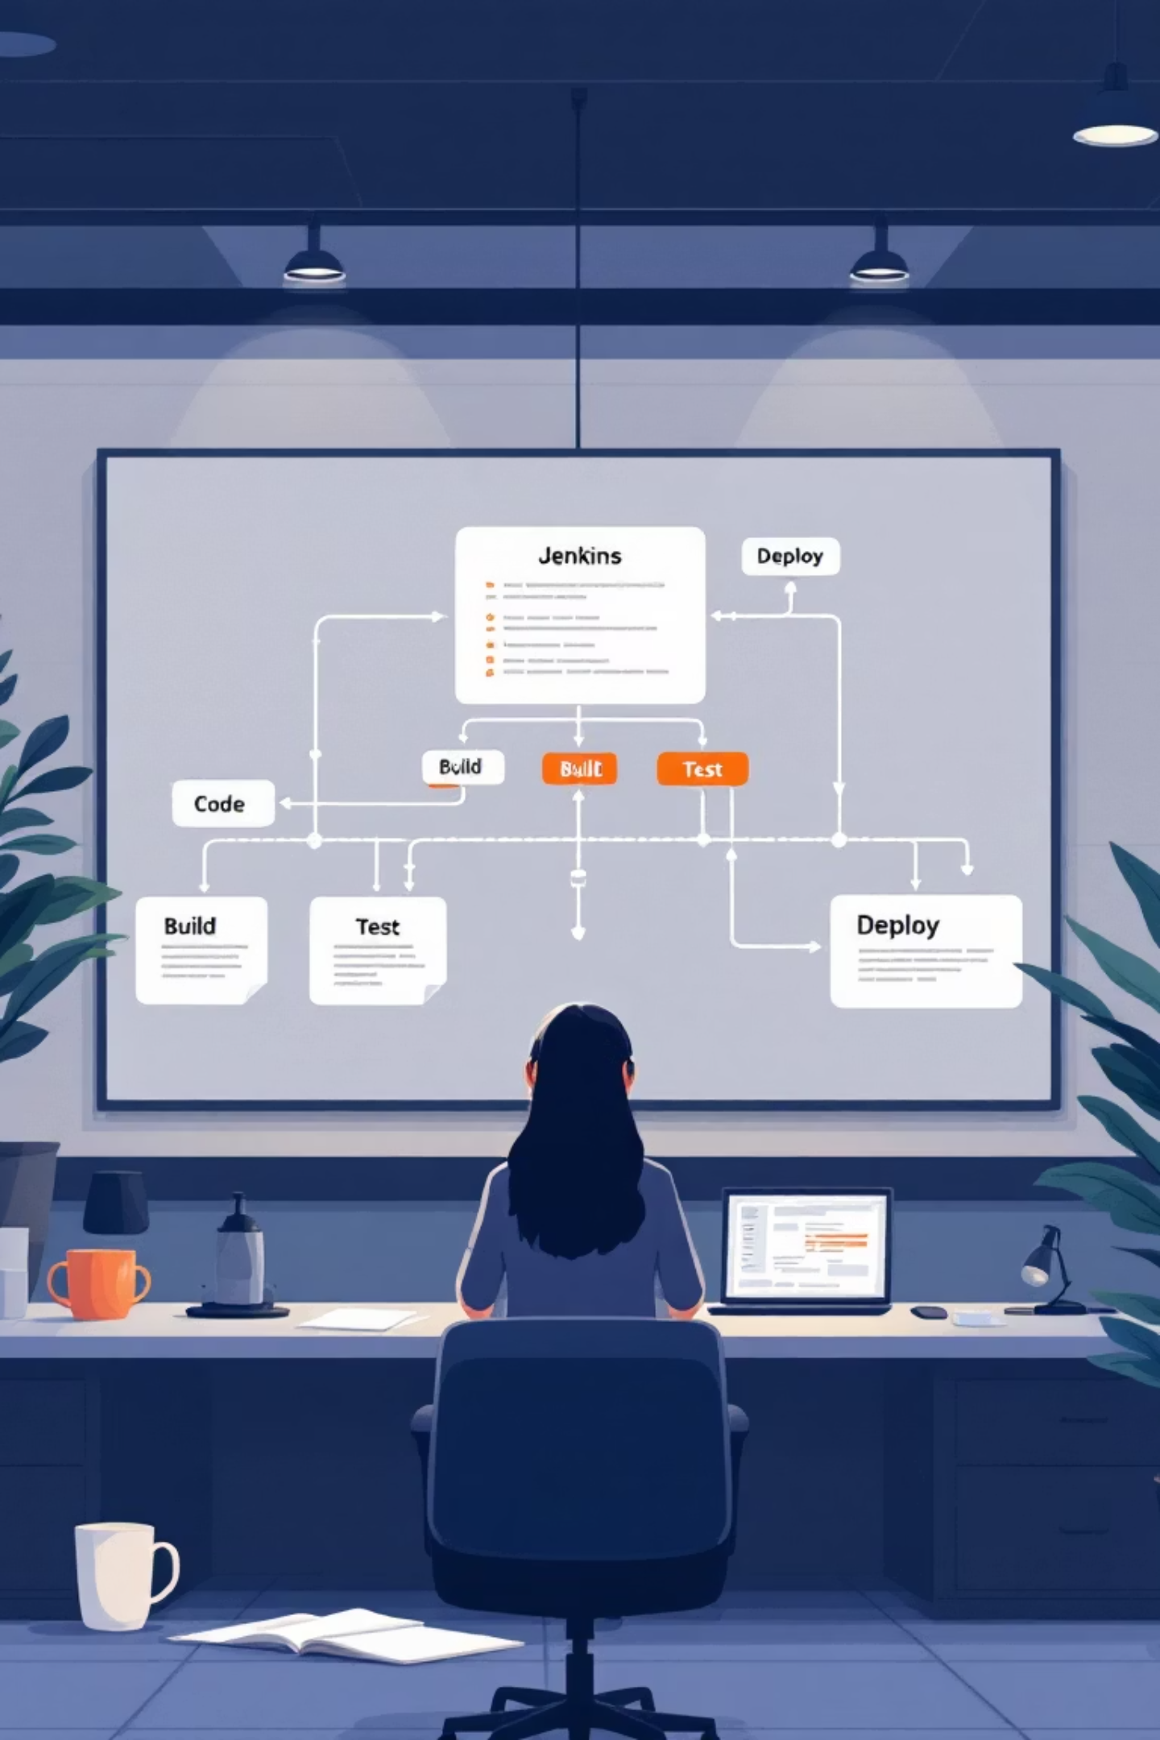
Jenkins Pipeline for CI/CD
The Jenkins pipeline orchestrates the entire automated workflow, ensuring that every code commit undergoes rigorous quality checks.
1
Checkout Code & Fix Permissions
Retrieves the latest code and prepares executable scripts.
2
Build Docker Image
Creates the Docker image with all necessary tools and code.
3
Run Flake8 Quality Check
Executes Flake8 inside the container; fails on errors.
4
Post Build Actions
Sends Webex notifications with build status and Flake8 output.

Slide 8
Jenkins Script: A Detailed Look
The Jenkinsfile defines the pipeline stages and steps, using Groovy syntax to integrate Docker commands, Flake8 execution, and Webex notifications.
pipeline { agent any environment { WEBEX_ROOM_ID = 'YOUR_WEBEX_ROOM_ID_HERE' } stages { stage('1. Checkout Code & Fix Permissions') { /* ... */ } stage('2. Build Checker Docker Image') { /* ... */ } stage('3. Run Flake8 Quality Check') { steps { script { def flakeOutput = '' try { flakeOutput = docker.image("code-quality-checker:latest").inside { sh(script: 'flake8 sample_app.py || true', returnStdout: true).trim() } if (flakeOutput) { currentBuild.result = 'FAILURE' } else { currentBuild.result = 'SUCCESS' } } catch (e) { currentBuild.result = 'FAILURE' } env.FLAKE8_OUTPUT = flakeOutput } } } } post { always { script { def finalStatus = currentBuild.currentResult ?: 'FAILURE' withCredentials([string(credentialsId: 'WEBEX_BOT_TOKEN', variable: 'WEBEX_BOT_TOKEN')]) { docker.image("code-quality-checker:latest").inside( "-e WEBEX_BOT_TOKEN=${WEBEX_BOT_TOKEN} " + "-e WEBEX_ROOM_ID=${WEBEX_ROOM_ID} " + "-e BUILD_URL=${BUILD_URL} " + "-e FLAKE8_OUTPUT='${env.FLAKE8_OUTPUT}'" ) { sh "python3 webex_notify.py '${finalStatus}'" } } } } }}
This script ensures that the pipeline is robust, handling success and failure conditions and integrating sensitive credentials securely.

Slide 9




Benefits of Automated Code Quality
Implementing this automated CI/CD pipeline brings significant advantages to the development lifecycle, improving efficiency, quality, and collaboration.
Automated Code Review
Continuous Integration
Reduces human error in style and formatting, freeing developers to focus on logic.
Ensures all commits are automatically validated against coding standards.
Improved Communication
Reproducible Environment
Real-time Webex notifications keep the team informed of build and code quality status.
Docker guarantees consistent builds and checks across all development and production environments.

Slide 10
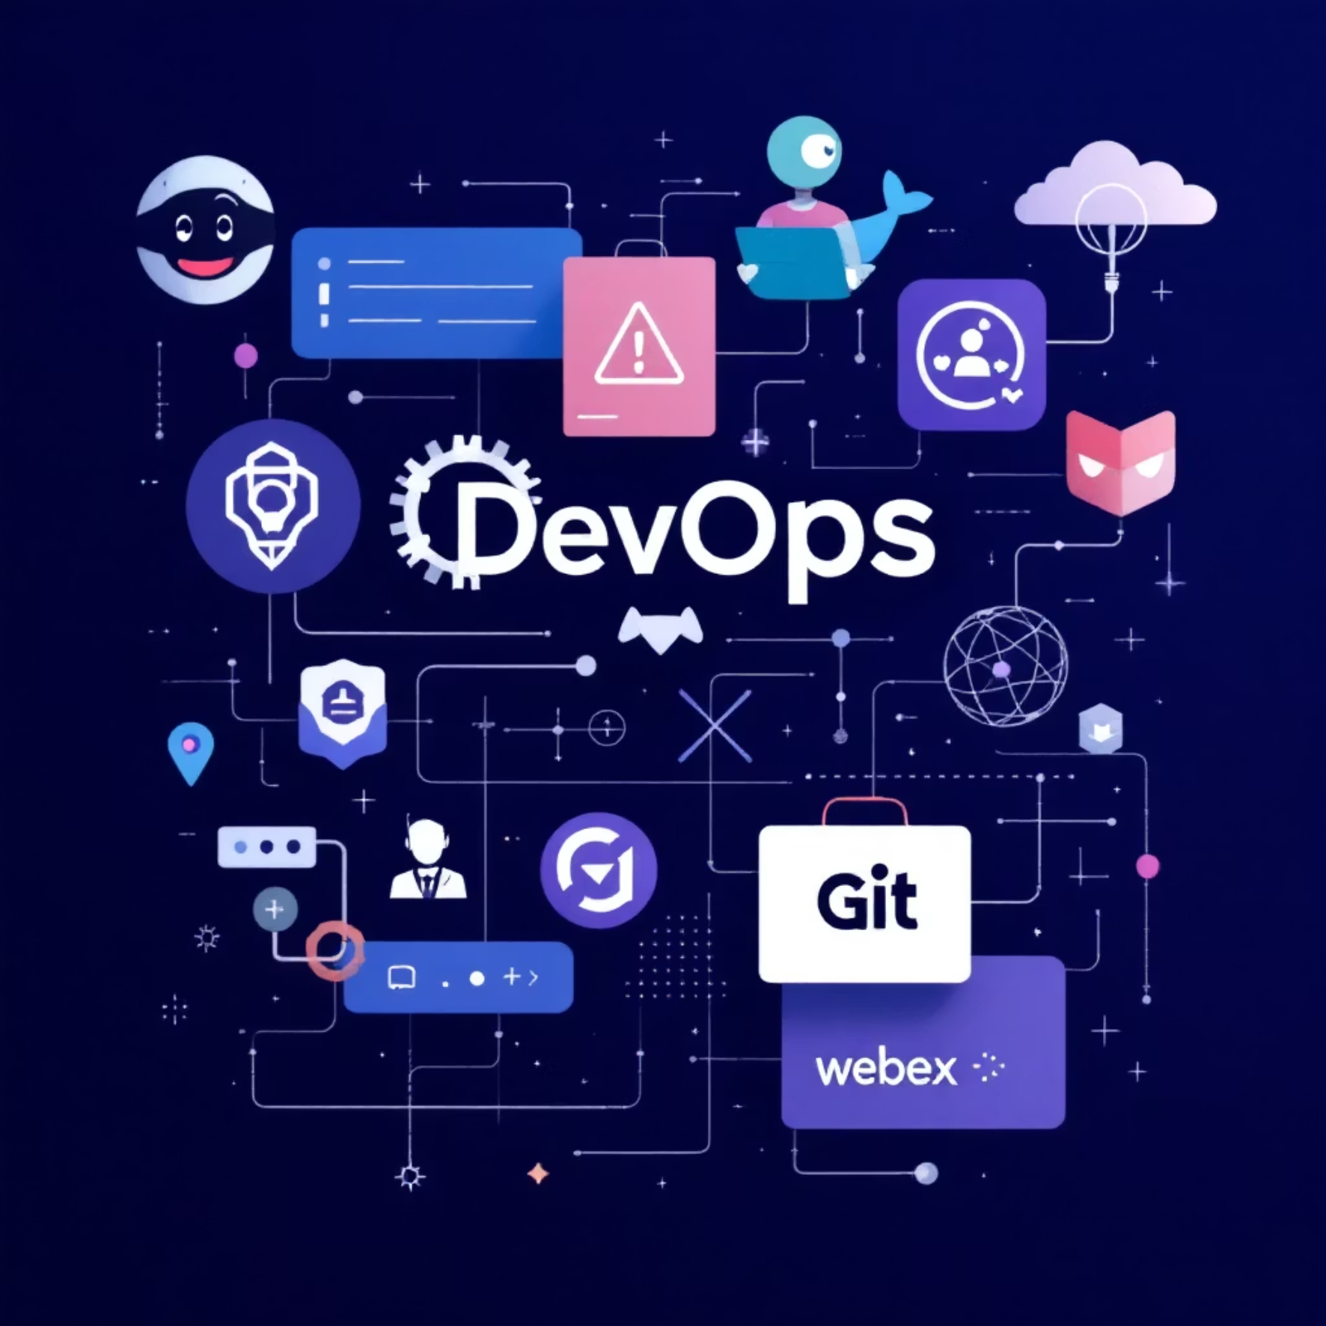
Getting Started & Next Steps
Set up this robust CI/CD pipeline to ensure consistent code quality for your Python projects.
1. Clone the Repository
git clone https://github.com/amanimaran14/devops-final-assignment.gitcd devops-final-assignment
2. Configure Jenkins
Install Docker on your Jenkins host.
Store your Webex Bot Token as a Jenkins secret credential.
Set the Webex Room ID in your pipeline environment.
3. Trigger & Verify
Trigger a Jenkins build to observe initial Flake8 errors.
Correct the errors in sample_app.py and re-run to confirm a successful, clean build.
Result
This setup enforces consistent code quality and automates feedback, leading to more reliable software.

